Slide 1
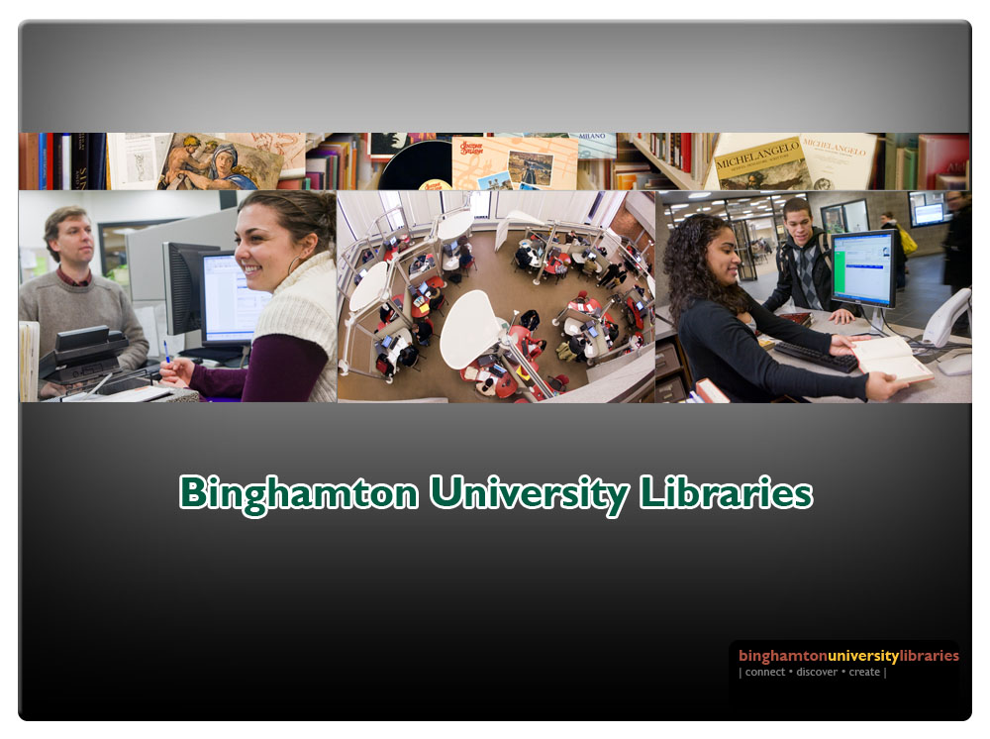
John M. Meador Jr., Edward M. Corrado, Sandy Card
Building Our Digital Library Using Rosetta and Primo: The First Year
A Briefing for the Rosetta Advisory Group
Hannover, Germany
July 17, 2012

Slide 2
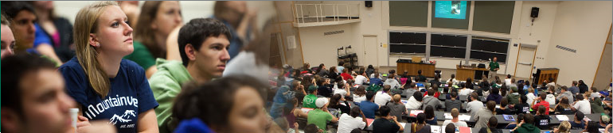
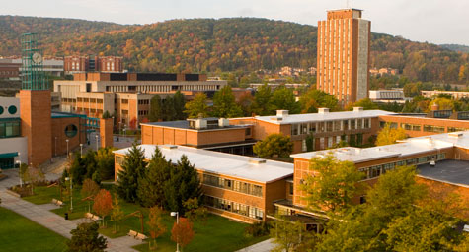

Binghamton University: SUNY
“The Premier Public University in the Northeast” and “best buy” (Fiske Guide to Colleges, 2010)
Undergraduates: 11,706
Graduate students: 3,007
Average SAT score range: 1190-1340
Average ACT score range: 26-31
Top 25% of high school class: 85%
In the past 10 years, 92% of freshmen returned for their sophomore year
Students of color: 33.3%
International students: 10%
Students come from all 50 states and 100 countries
#1 in 2011 as a best value among the nation's public colleges for out-of-state students and #5 overall (Kiplinger's Personal Finance, 2011)
One of the nation’s top 50 public universities for the 13th consecutive year (U.S News & World Report, 2010)
#6 best value for public universities based on academics, cost of attendance and financial aid (The Princeton Review Best Value Colleges for 2010")
8th most selective public university (U.S. News & World Report, 2008)
16th among public universities and 57th among all public and private universities in the nation (Forbes, 2008)
School of Management ranked 18th best public business school in the U.S. (Business Week, 2010)
4-year graduation rate of 80% is 3rd best in U.S., with 60% continuing to graduate or professional schools

Slide 3
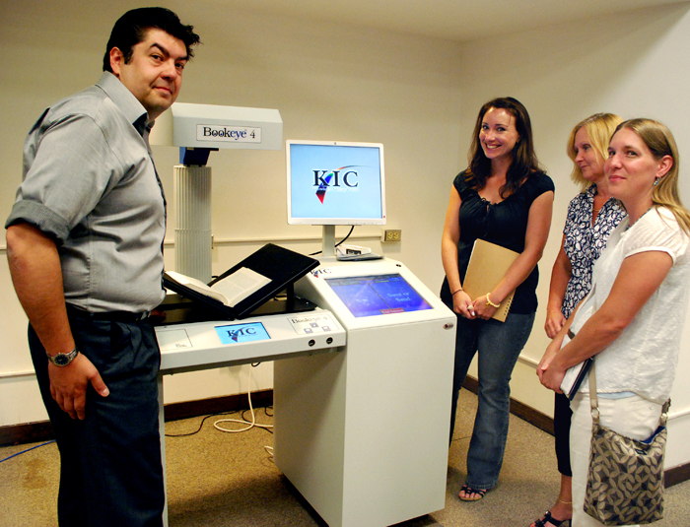
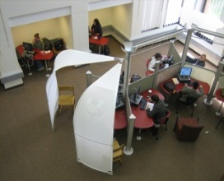
Binghamton University Libraries
3 libraries + 1 remote storage annex
  Bartle Library is open 24x6 with self-check and walk-up digitizers
  3 Information Commons containing 287 workstations
2.5 million print volumes
  A 2007-08 OCLC-sponsored comparison of collections among 18 libraries found 15% of our holdings were not held by the others and 50% were held by fewer than five of the participating libraries (including Brown, GWU, Ohio State, Alabama, UCLA, Georgia, and Virginia).
  A January 2012 analysis by OCLC Research reveals that 63% of our collection is not duplicated in the Hathi Trust Digital Library.
Top rated by campus community
  Our libraries received a mean student satisfaction of 95.9% (highest on campus) in a recent survey by Institutional Research
  An alumni survey (graduates from 1999-2007) scored libraries 4.01 (out of 5), which was highest among all categories surveyed
  Mean ratings of student surveys conducted between 2000 and 2009 revealed a student satisfaction rating increase from 3.68 to 4.12 on a scale of 5.0

Slide 4
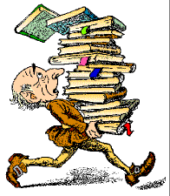
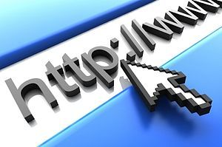

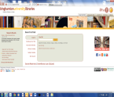
Binghamton University Libraries: Traditional & Transformative
Mission
Binghamton University Libraries bring people and information together utilizing value-added local initiatives to enhance learning, teaching and research in ways that achieve national and international acclaim while strategically advancing our University’s Mission and Reputation.
Values
We value a collegial, collaborative and creative organizational culture that encourages experimentation focused upon assessing and improving the effectiveness of our users’ experience.

Slide 5
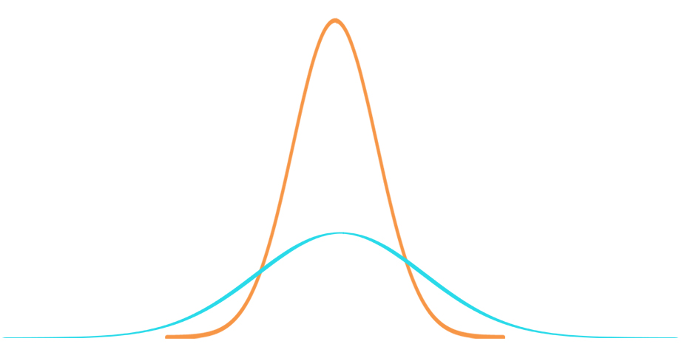
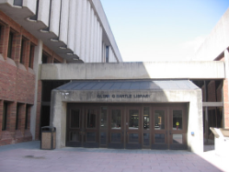
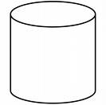




Digital Repositories Emerged as the Web “Flattened” the Bell
Curve and Adopted Chris Anderson’s “Long Tail” Perspective
Traditional Libraries
Branch Libraries
Branch Libraries
Digital Repositories
Digital Repositories
Digital Repositories
Digital Repositories
DPLA
Niche Interests
Shared Interests: Collective Collections
Niche Interests
“The Long Tail” by Chris Anderson in Wired (October, 2004) & his book: The Long Tail: Why the Future of Business is Selling More of Less. New York: Hyperion, 2006 and its Revised and Updated Edition, 2008.

Slide 6
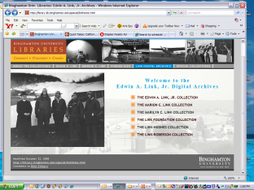


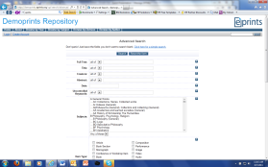

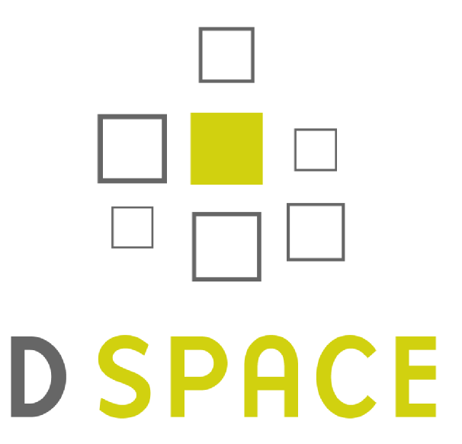



Our Rush to Digitize Resulted in Unlinked Digital Collections & Interfaces with No Preservation
Licensed
commercial
e-resources
OCLC’s
CONTENTdm
Innovative’s
Content Pro
We became opportunistic, both in terms of our rush to digitize and our experimentation with OCLC’s CONTENTdm®, SUNY’s Dspace, , and even as a development partner for Innovative Interface’s Content Pro. However, like our national peers, we overlooked cross-collection searchability and long-term preservation.

Slide 7
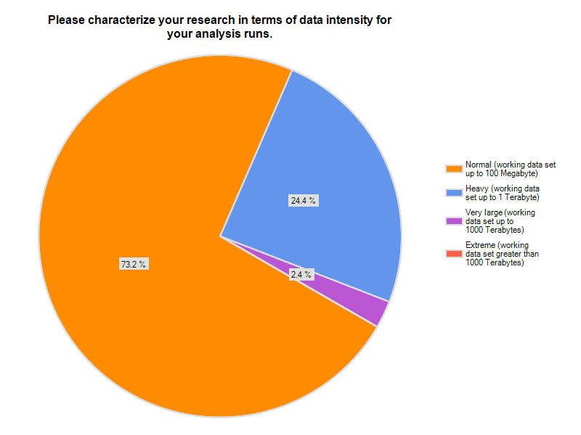
Survey of Binghamton University
Research Faculty, June 2011
Asked 308 individuals who either had an externally sponsored project since 2009 or who had submitted a proposal during that time period to take survey. By June 15, 2011, 91 respondents completed this Survey. (Conducted by Jim Wolf, retired Director of Academic Computing)

Slide 8
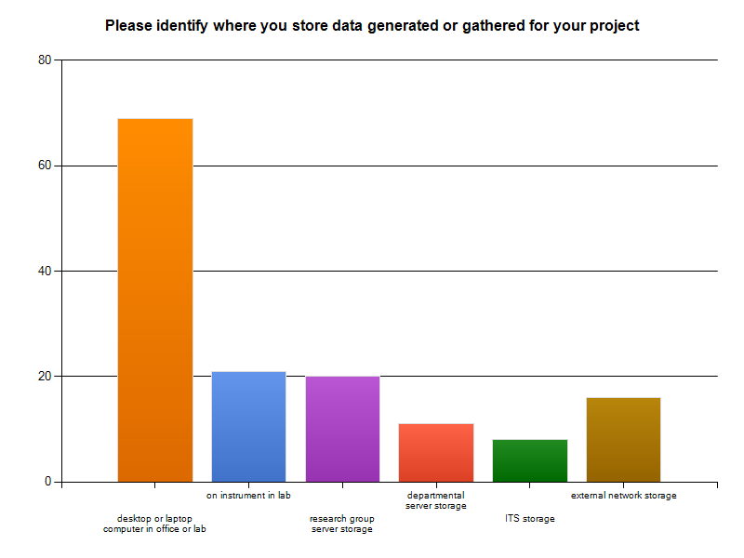
Where Faculty Keep Their Data

Slide 9
Their Desired Preservation & Access
Preservation Timeframe
Accessibility

Slide 10
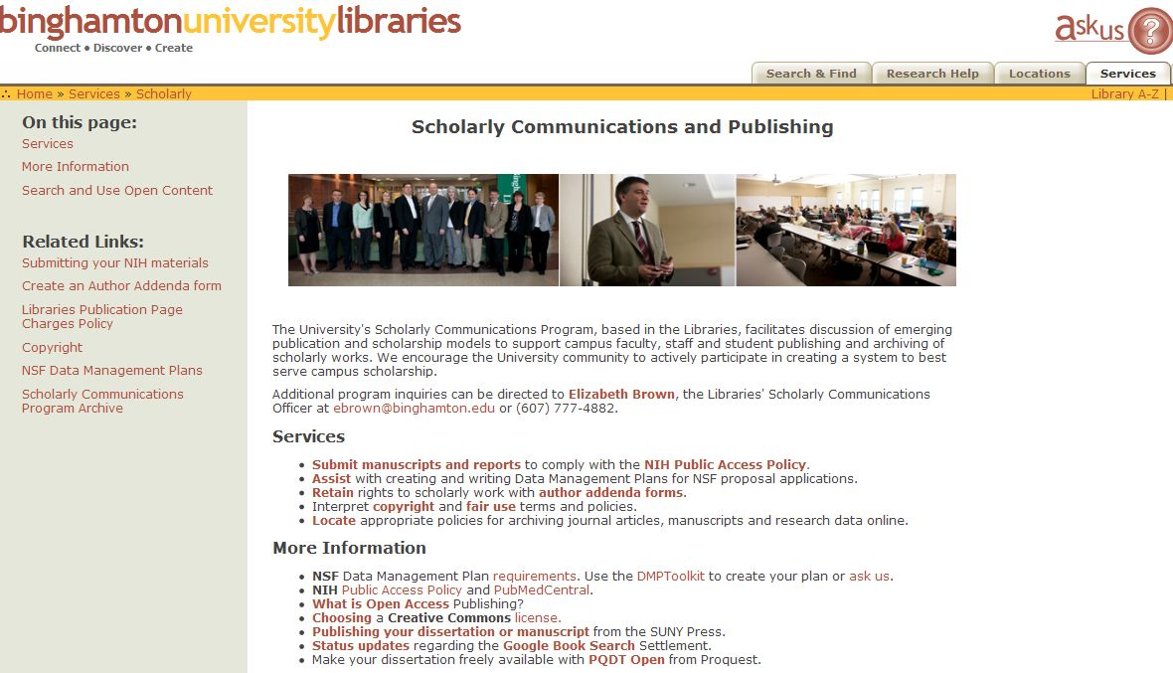
Our Libraries’ DMP Support
NSF Data Management Plan Information
URL: http://library.binghamton.edu/services/scholarly/index.html

Slide 11
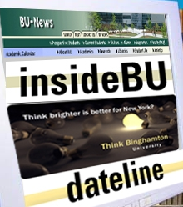
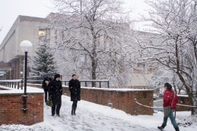

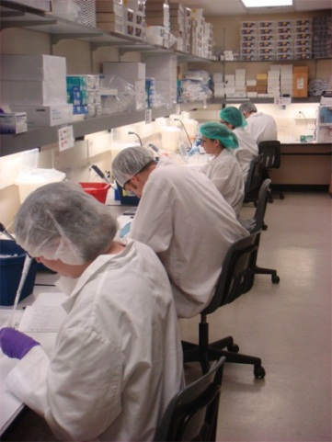

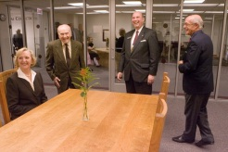
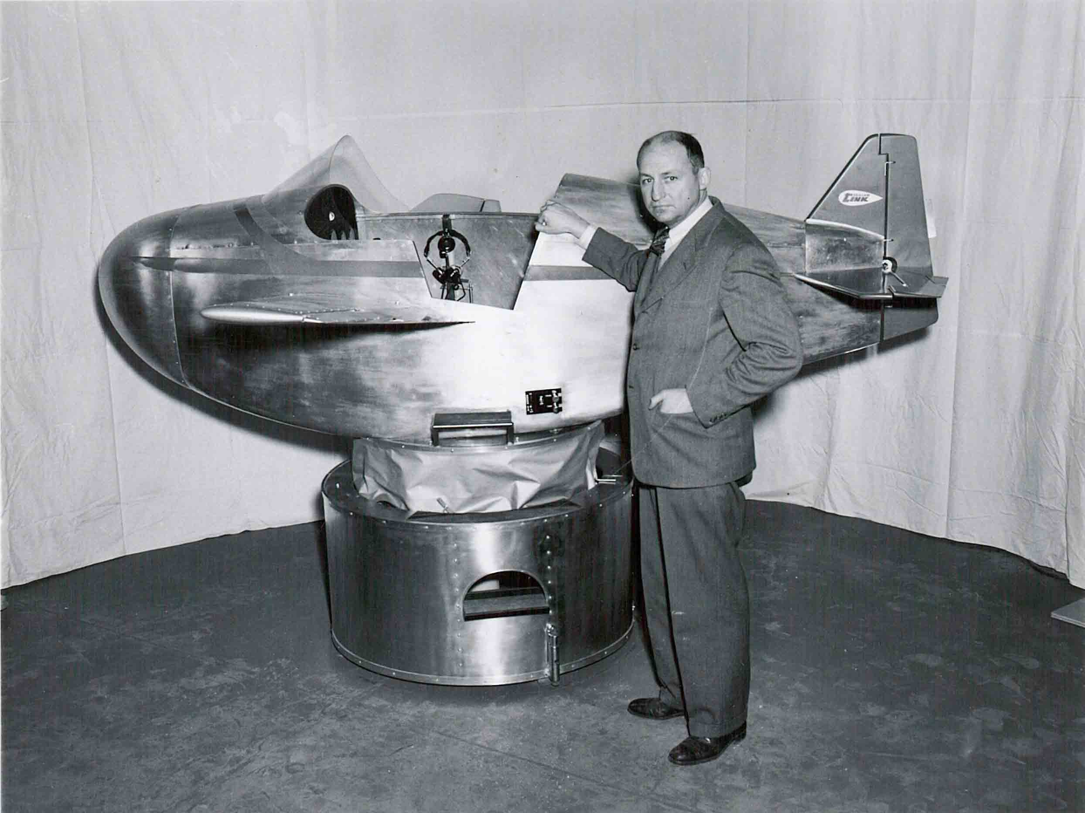
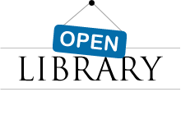
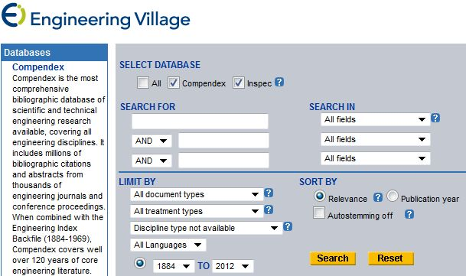

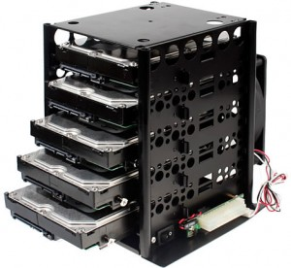
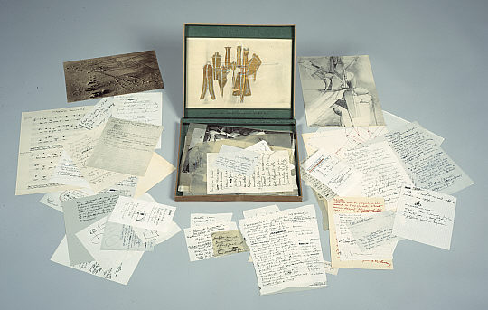
Building a Digital Library
in a “Cloudy Environment”
DPLA
DPLA
Primary Research Resources:
Born Digital Institutional Memory & Digitized Special Collections in
Secondary Research Resources
in the “Cloud”
Primary Research Resources: Data Sets in

Slide 12
Hathi Trust Holds 5.5 Million Titles

Slide 13
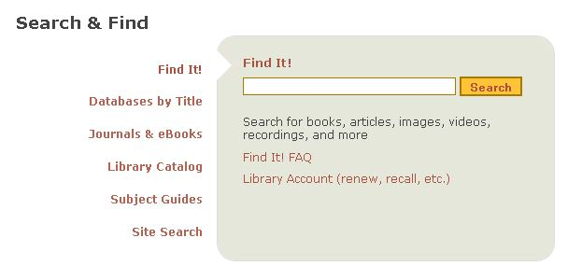

Our Holistic Concept of a Digital Library
Branded Cross-Collection Search of Commercial, Collective and Locally Preserved Collections
Licensed Commercial e-resources
Digital “Collective Collections”
Local Print
in
Local Digital
in

Slide 14

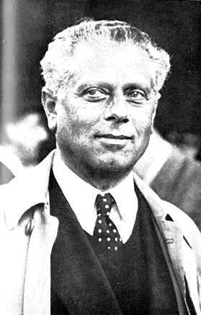
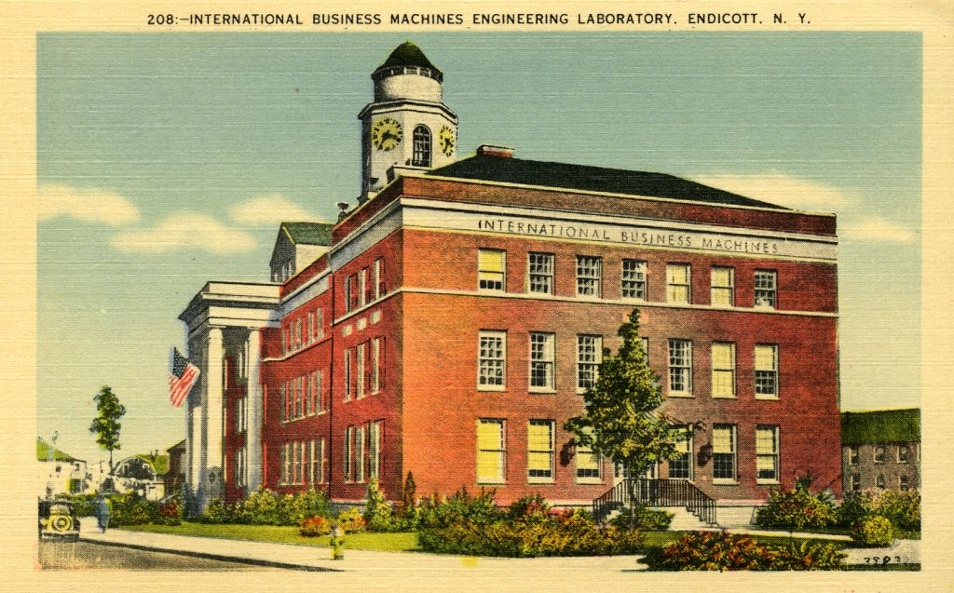
Ingesting Local Digital Collections
Library Projects
Office of Communications and Marketing
Faculty/Scholarly Materials

Slide 15
Library Projects
Mostly digitized photographs but also letters and some audio and video
University Archive Photographs (digitized photographs)
Saeedpour Kurdish Collection (photographs of physical objects)
Postcards (Cizenski Postcards Collection; Local History Postcards Collection)
LibraryLinks (newsletter)
Green Letters
Dickinson Letters
Music Recitals (digitized audio, will be a dark archive)
  In planning stages

Slide 16
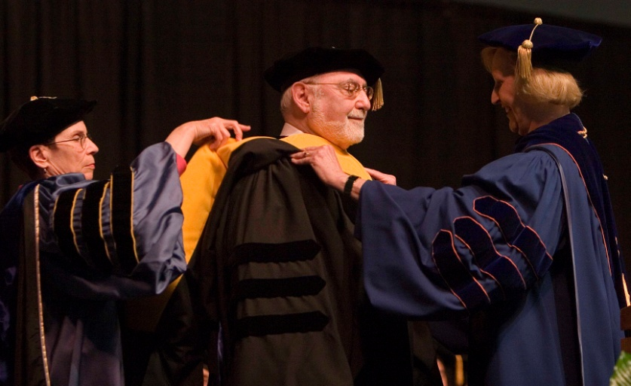
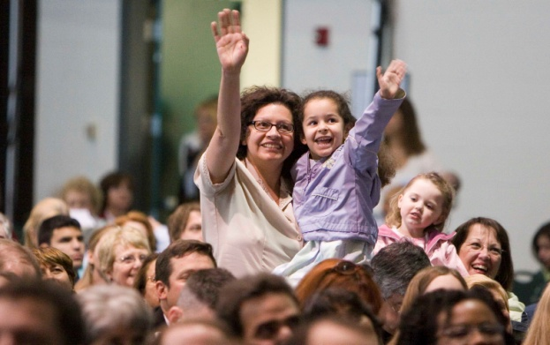
University Office of Communications and Marketing
Newsletters/Campus Magazines
  Dateline (daily e-mail newsletter)
  Inside BU (Web Magazine)
University Photographer
  65,000+ edited photos
  400,000+ raw photos

Slide 17
Faculty/Scholarly Materials
Blood Serum Archive
  Graduate students working under the project director are creating metadata
  Approximately 1/2 TB of scanned documents
  Should be loaded at the end of the summer
College of Community and Public Affairs (CCPA) Capstone Projects
  Working with students studying Library & Information Science at the University of Missouri to create metadata
Electronic Theses and Dissertations (ETDs)
Online Journal of Rural Nursing and Health Care

Slide 18
Preserving Research
In the planning stages/conversations with leading faculty members on campus representing interdisciplinary programs with researchers from Bioengineering, Computer Science, Chemistry, Engineering, and Physics
Provides the Libraries an opportunity to demonstrate Rosetta (and the Libraries) capabilities and educate faculty about digital preservation
Scholarly output
  Articles, proceedings, etc.
  Research data (working & archival)
  Related material including grey literature, research notes, lab notebooks, correspondence, etc.
Notes:
We are still at the preliminary planning stages, however we are nearing a point where we will be getting more heavily involved in this area

Slide 19
Undergraduate Education
We discussed Rosetta with Binghamton’s Vice Provost for Undergraduate Education
  Honor theses
  Student scholarship (e.g. posters at national conferences)
  Student Lab / research data (as part of the educational process)

Slide 20
Research Data: Some Thoughts
Enlist subject librarians to help make connections
  Subject librarians are identifying possible data needing preservation
Work with faculty on federally mandated data management plans
  Many granting agencies such as National Science Foundation (NSF) are requiring data management plans
  Get involved early
  Assist with submission requirements for research funding

Slide 21
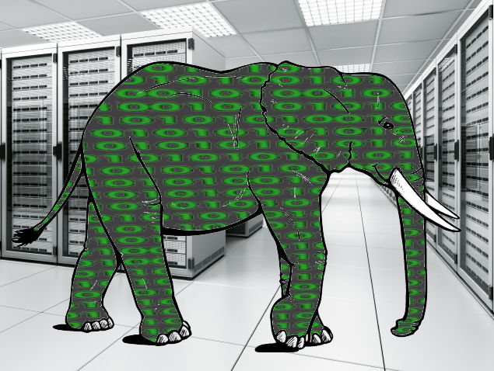
Research Data: Some More Thoughts
Provide preservation; offer dissemination
  Don’t confuse preservation with open access
  Faculty don’t always want or can not always make data open
    Dark archive if desired
  Do not need to replace or replicate current data dissemination methods (unless researchers desire)
Not all research data is “Big Data”
Photo: http://siliconangle.com/files/2011/07/Big-Data.jpg

Slide 22
Metadata
Metadata Librarians as project managers
Not what they were originally hired to be
Requires a different skill set
  Student supervisors
  Consultants
  Teachers
  Liaisons
Allows for multiple projects
Needed a way to make sure all projects were created consistently
Notes:
From the metadata point of view, preservation is very important but retrieval is critical.
There were 2 major ideas that guided our work over the past year. From the start we had decided that we would try to use the best person to create metadata, not just the available person. In some cases this was our metadata librarian, in some cases it was a student, in some cases it was students from outside the library.
Working with this concept we realized that the metadata librarians were the best people to be the project managers. Since we had 2 project managers and had the potential for a lot of people to be working with metadata it was necessary to find a way to make sure the metadata was consistent.

Slide 23
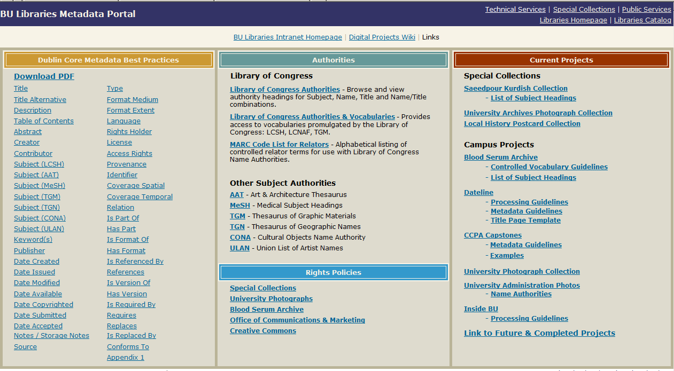
Metadata Librarians Created a Metadata Portal
Notes:
The need for consistency led to the creation of a metadata portal.
On the left side we have a list of each of the metadata elements and refinements we use. We looked at the basic 15 elements of DC but felt they were not enough since they did not cover everything we wanted expressed. We found them to be a combination of too vague and not flexible enough. We ended up using most of the 15 elements plus their refinements but in a couple of cases we are using only the refinements and not the original element. “Rights” and “Date” are two of these unused elements. The core field of Date was simply too generic so we opted to go with all of the associated refinements for date but not the original core element of date.
The middle section of the portal has 2 sections. The top section contains links to information about authorities including links to, for us, lesser used systems such as TGN – the thesaurus of geographic names. With the exception of the mesh headings, the thesauri are from the Getty Research Institute. The lower portion of this section has links to rights policies. In some cases there is a complete policy to be used for the public, in other cases it may simply be a note of who to talk to if someone has a question about the collection.
The last section allows us to keep a list of current projects we are working on as well as a link to both future and completed projects. For example “Dateline” is one of our ongoing projects. Dateline is a daily informational email each staff member receives. It contains the days announcements. There can also be “special bulletin” datelines. They are born digital so capturing them is a way of preserving the day to day history of the University. Note that there are both Processing Guidelines and Metadata Guidelines for this project.

Slide 24
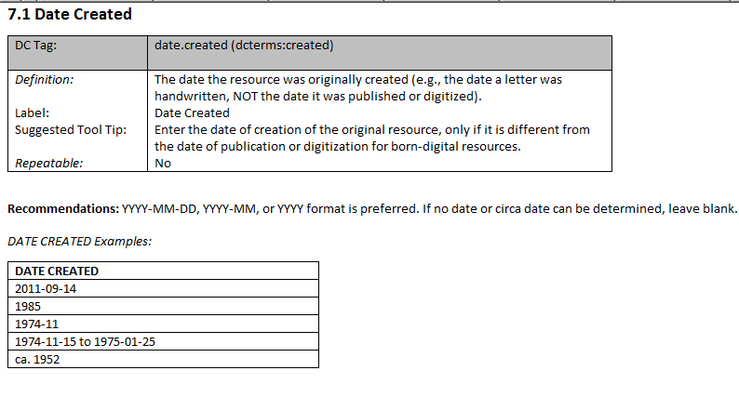
Notes:
If we look at one of the links for our Dublin Core element refinements, date created, you can see that there is a definition of the term with an example, the label the term should use, the suggested tool tip and whether or not the term is repeatable. There are then instructions for the format for the date. These instructions help everyone who may be creating metadata stay consistent with the terms usage.

Slide 25

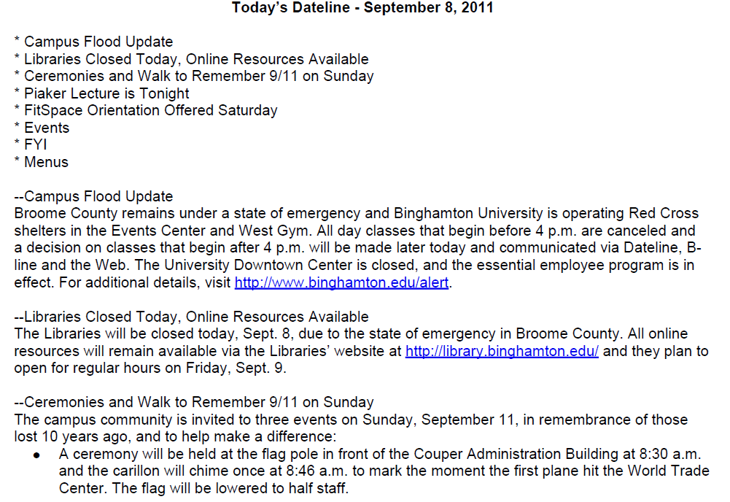
Notes:
We had a terrible series of floods last September and Dateline was a major vehicle of messages. While some of the messages are more important than others, capturing them is an important part of our history. In this case it not only “dates” the flood, it shows that the campuses response. For example our event center was used as a red cross shelter for the community. The flooding became much worse than anyone expected and we had guests in our event center for almost 2 weeks before they could be relocated to other shelters. Thousands of BU students volunteered to help and are still even today working with the victims.

Slide 26
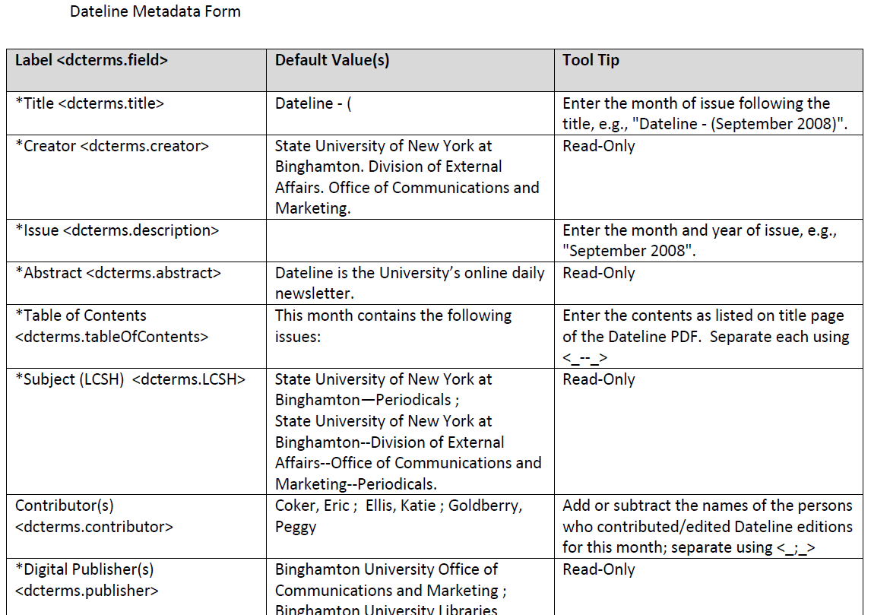
Notes:
Metadata Guidelines: Clicking on any of the projects, whether ongoing or completed will show you the metadata form. The form shows which fields were selected for a particular project, their labels, any default values and tips and explanations of the fields.
Because we have this level of explanation to explain how to create the metadata for “Dateline”, we can easily have a student, with a metadata librarians guidance, create the metadata.

Slide 27
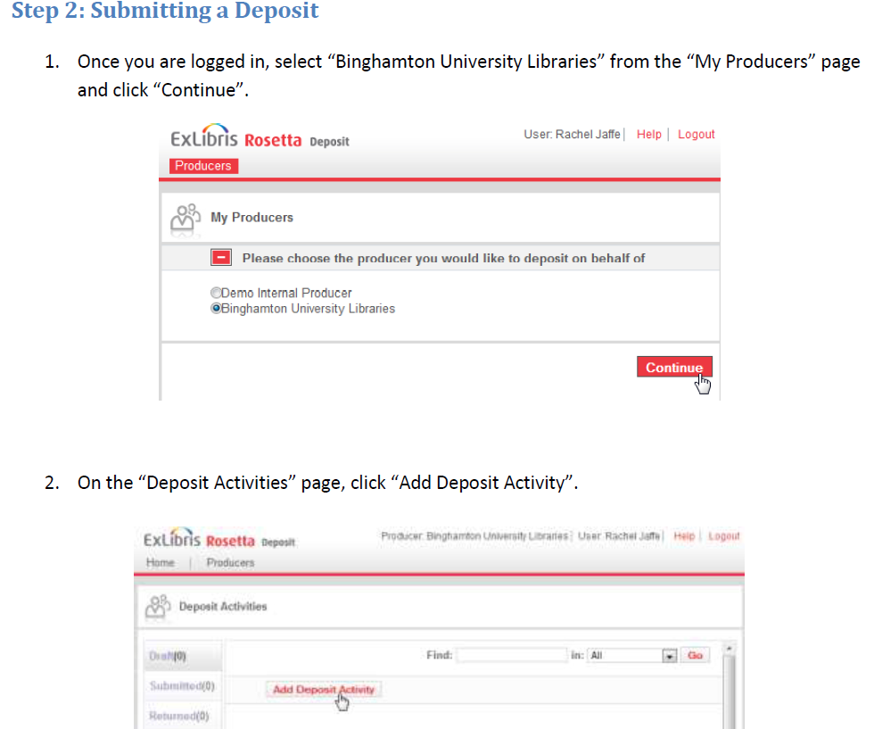
Notes:
Under the Dateline directions we have step by step instructions for all parts of the project, from what fields will be used for the metadata, to creating the PDF to submitting the IE for ingestion.

Slide 28
While Preservation is Critical for us, so is Retrieval.
We need:
Ability to do easy editing and make global changes on the metadata.
Ability to have or link to authority records for names and subject headings.
Ability to have some fields in the metadata available for the public but have other fields in the same record remain dark.
Notes:
Ability to reject a SIP without losing changes :When a SIP has been deposited and changes to the metadata have been made by the Assessor, if the SIP is then rejected, those changes are lost. The metadata reverts back to what was originally submitted. It seems the workflow is designed only to push SIPs forward; it doesn't allow for backtracking. If we get to the stage where we will be trying edit or update metadata exclusively within Rosetta, at various points in our libraries' digital projects workflow, e.g., bouncing metadata back and forth between metadata creators/depositors and the metadata librarians, this could prove to be a real hindrance.

Slide 29

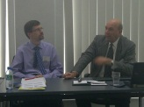
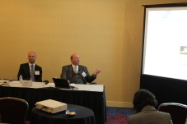
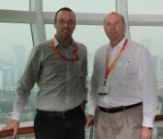
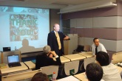
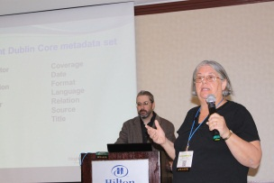
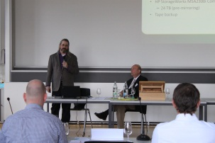
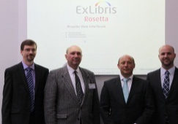
QUESTIONS?
Washington
Stockholm
Singapore
Hong Kong
Salt Lake City
Zurich
London

