Slide 1
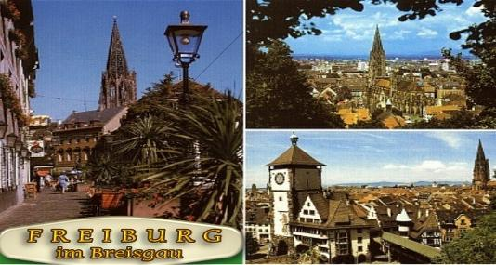
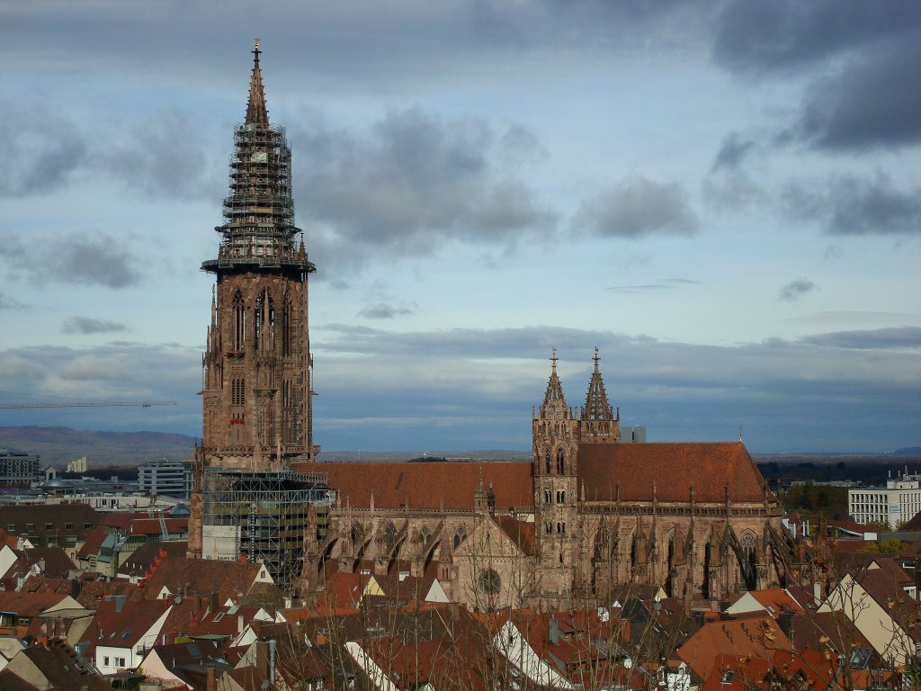
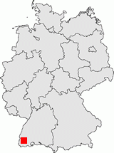
Migration, Emulation and beyond
– more challenges looming on the preservation horizon –
Gerhard Schneider
IT Centre, University of Freiburg, Germany
direktor@rz.uni-freiburg.de

Slide 2
Facts ..
More and more documents are available „only“ in digital form (born digital)
  Or are being digitized (sometimes in a tedious way)
„digital Preservation“ requires more tought than for just „storing paper“
  Paper usually is not upset if nobody cares about it for more than 200 years
  Electronic media technically last longer than their expected life cycle.
    Floppy disks still „exist“
  „successful retrieval“ – what is the meaning of „1“ and „0“ in a given context?
    the art of reading hieroglyphs was once lost
Strategy papers start to appear … ☺ ☹
“

Slide 3
Facts
Electronic journals make things worse ☹
  Access rights only for a limited time period ??
  Open access journals with unclear mode of operation
A dead „operator“ takes the data into his grave – even if they were once owned by someone else.
  And Amazon already deleted a book from all kindle machines, although it had been paid for.
  To ensure market separation, manufacturers prefer proprietary software formats which can only be read with their hardware.
    A current trend in the ebook market!

Slide 4
Copyright laws
Copyright laws are used to defend the proprietary worlds
  Licence to print money
  Who stops a producer from declaring an old format to be obsolete, only to resell the old and well known (but legally proteced) contents once again to the beloved customer?
    Records -> CD -> copy protection -> blueray
    Open formats / open technology (like PC) on the retreat?
    ACTA … ?!?!

Slide 5
Libraries ??
What is the task of a library?
  Preserve and find again
Will this task be valid in the future?
  Preserve, find again, discover unusability, throw away ????
Give up?
Let us restart ….

Slide 6
The easy part
Data – if it exists in the sense of „ownership“ – is stored on storage media
And a computer centre can copy the data from one storage media to next generation media
  Without any loss of quality!
  Quality ensurance of the copy process is no problem
But: time is a factor
  E.g. small IT-center Uni Freiburg: tape robot with a capacity of 3 PetaByte (soon).

Slide 7
The easy part (2)
Freiburg:
  16 tape drives TS1120 with 100 Mbyte/sec each
  Reading all data thus requires (best case): 22 days
  New TS1140 drives: 2,5 x faster
  Delays by additional hardware, data transfer channels, etc
The mere migration of all data to a new technology will probably take something like 6-12 months
  Migration must therefore be started well before an old technology begins to expire.
  This seriously contradicts public funding concepts.
Example from another world:
  Try to fill a 16GB USB-stick – this requires several hours.

Slide 8
The easy part (3)
For an IT centre long term archiving is more like a „life insurance“
  Nobody can do it better and it is a core business
  If you close the IT centre, all data is lost
    And thus (part of) our cultural heritage
    And if a library tries to do the job instead of the IT centre: no difference but at least as expensive.
Lesson learnt: digital long term archival requires a continuous investment in hardware
  Well, books do require tender loving care too – air conditioning, etc
Good news: the necessary technology is not too expensive – and the work flow can be automated

Slide 9
Libraries – expecting the unexpected?
If you believe in
  Digitizing = scanning photos and documents
  PDF-documents
  Static web pages (harvesting html)
then you cherish a wrong view
And take wrong decisions for the future ☹
A glimpse of the future:
  Check your stock for computer games (with OPAC reference), early e-learning environments, etc
  And you find data that require a run time environment for presentation
  What do you do? Throw them away?
    What will social scientists say if they try to expore the beginnings of virtual environments = computer games?

Slide 10
Libraries – expecting the unexpected? (2)
Digital data is not necessary static – at least not in a networked world.
  Example: a text book which tries to enhance the understanding of an economy by presenting real live data from the stock exchange
  It is of no help if some experts believe that such a scenario is rubbish
    It will happen anyway
  Example: a text book which tries to enhance a concept via real live simulation runs on a computer
    „Energiewende“ (using new energy sources): influence of side conditions on the mix of energy sources (like storage capabilities)
Such things do not exist?

Slide 11
Apple ….
Are building their own eco system:
  Software Apple iBooks author …
  quote from http://www.apple.com/de/ibooks-author/
  iBooks Author. Produce and publish amazing multi-touch books for iPad
  iPad as ebook-reader (online via WLAN, UMTS)
    Finally „ubiquitous computing“, „always on“
    Touch-interaction
      More than turning pages: trigger actions and activities
    Multimedia (video, sound, sequence of pictures, simulations)
      Integrated on one page, inline
      Contents is loaded online
        And is only available for a limited time period (?)
Compare this with school books and their 15 year old data

Slide 12
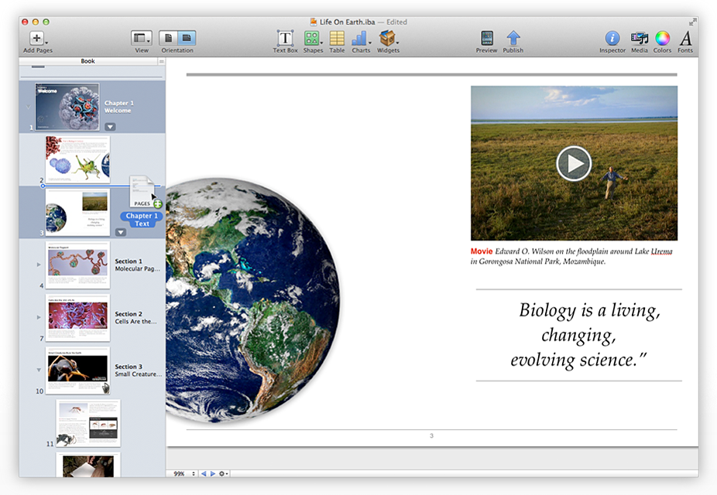
Apple …. (2)
With galleries, video, interactive diagrams, 3D objects, and more, these books bring content to life in ways the printed page never could.
ignore this??
  It is perhaps the future!
  Rather read 10 pages of dense print to understand cellular reproduction – or rather watch a short (and good) film?

Slide 13
Challenge for libaries ?
How do you preserve this „book“?
  Put the iPad in a box?
    Threat it like a book?
    And what about its online contents?
    Maybe in 10 years the archived iPad will be empty
      The batteries will be dead anyway and cannot be changed
A singular case?
  DFG requests that research data should be preserved for at least 10 years.
    More precisely: the scientists want this and request it via the DFG
  Naive: research data are like weather data
  Reality: electronic lab books are used to document experiments in a lab.

Slide 14
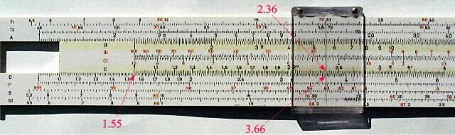
Challenges …
Electronic lab books are proprietary software environments with proprietary storage formats
  Technology may well need new formats and standards are not yet set
    And maybe can never be set ☹
  To read and interpret the data you need a run time environment
    Which will be 10 years old in 10 years ☹
      And may no longer exist
      Perhaps in 10 years we will no longer have Windows, only iOS or Android (or the other way round)
  Even if you can read the data – who will be there to operate the software to achieve reasonable results?
    Usage skill of software is a time dependent component of our culture

Slide 15
Challenges
DFG upgrade: Data management concept
  Better – but not good enough!
  At least this prohibits a „put data on a DVD and store it in a drawer“
Digital long term archival also contains:
  Long term availability of data and of the complete environment
  Otherwise we will not be able to re-run our learing process of the past
    The classical school book won‘t be around any more.
    Terrible idea? Perhaps not.
    But what if the basic data sets necessary for the knowledge gain have vanished? KTvG may have loved this idea

Slide 16
Challenges
We start to realize :
thanks to the technical deficiencies of the storage medium “paper” we were forced to go to an abstraction level that allowed a two dimensional static presentation (i.e. set and print)
Despite that natural sciences always had problems to present complex experiments “on paper”:
  Easy if the experimental setup is easy to describe and easy to replay
  CERN: measured data depends on the construction of the accelerator, regardless of how much data you record.
    How do you prove later that the setup was wrong?

Slide 17
challenges
The digital world allows for a much more comprehensive knowledge transfer
  Present run time data rather than a mere description
Archiving such data is getting more complex
  Archive the run time environment
  Archive the online environment
  Archive the current state of the world ☺
    Even facebook archives only what it wants to archive
We lack the abstraction from the „possible“ to the „doable“ – or have not yet tried
What should we do?
  Watch in despairation?

Slide 18
Solutions – in some areas
„some“ data requires software for representation
  In a special version
    Winword 2.0 …
  Which only runs in a special environment
    Win95, NT,….
  Which requires special hardware and drivers
    Control centre of a power plant…, Apple Newton, PalmPilot
  Which once worked in the past
Migration as an attempt:
  Data is read with the last software version, which can handle the data, and is stored in a new format.
    Is the new presentation faithful?
    Will the new Excel still get the same results?

Slide 19
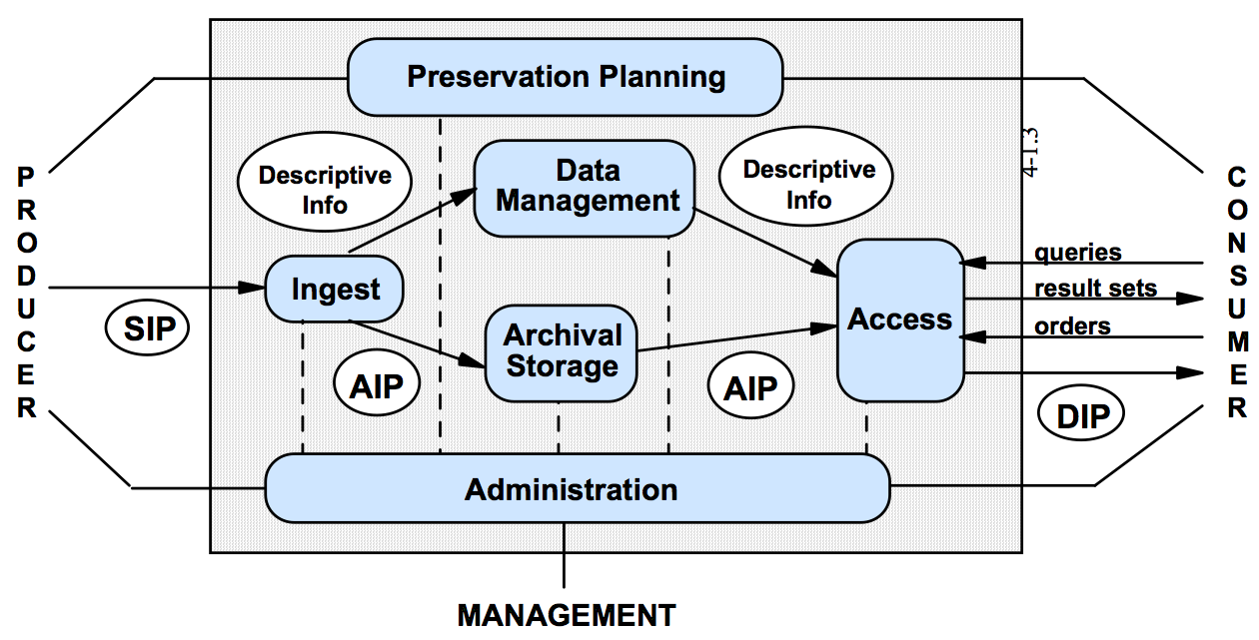
Long-Term Archival Model (OAIS)
Fatal flaw: total dependance of the run time environment not taken into account
The concept will soon require an update ☹
Notes:
describe and store (savely)

Slide 20
In search of solutions
  Functional long term archival
    Archiving the complete run time environment
      As a virtual world
        Hardware → Software
      Complete environment becomes a „data collection“
        Zip-file which includes the computer
      We have real confidence that we will be able to run this virtual world in the future
    Archiving the scenario of software operation
      As screen dumps / films of true scenarios
  What metadata do we need to describe such an approach?

Slide 21
bwFLA – Functional approach
DO Formats and Types
Applications and Software
Operating Systems
HW
FLA
Functional approach
  Preserve a system environment
  Emulation as a tool
    Access to digital objets, ie. rendering, use and migration
  → Preservation Planning / Preservation Action
  focus on a small set of components

Slide 22
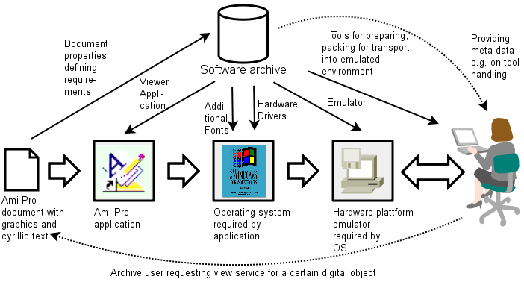
Viewpaths & SW-Archive
View-Path of a Lotus AmiPro document

Slide 23
bwFLA – project aims
project focus:
  Interactive documents
    E.g. e-learning – Objects with complex internal structures, interactive DOCs with macros
  DOs with a complex internal structure require the analysis of the full system setup (“rendering”)
    E.g. data base with complex view-layer (e.g. CMS)
    → authentic and complete re-enactment of such DOs in their original environment
  System Preservation
    Collection of independet DOs
    E.g. scientific data with “build your own” tools for analysis and problem related workflow

Slide 24
bwFLA – project aims
target: present a framework as well as workflows to ensure a long term access to digital objects via emulation
bwFLA – a user centric approach
  Use user knowledge to identify all prerequisites of the DO w.r.t the original environment such that the “rendering” yields a complete environment which is free of dependency conflicts
  Preserve knowledge about installation, configuration and use of these objects and environments
  Give a “preview” on the quality of the rendering for objects and environments

Slide 25
bwFLA – Ingest Workflow

Slide 26
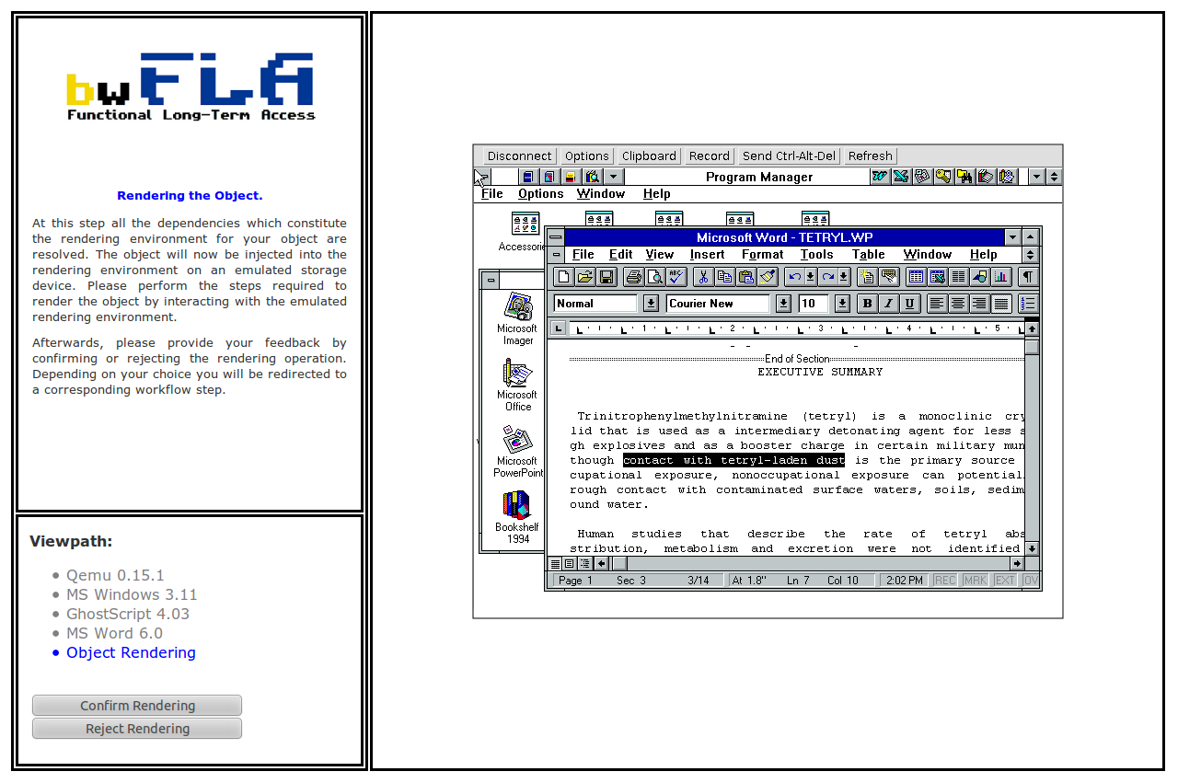
bwFLA – Ingest Workflow

Slide 27
Software Archiv
Viewpath generation workflow
  → bwFLA presents a web based environment which allows a structured installation process on a reference machine
  → and thus contains a verified and technically complete set of metadata about the software components
Emulation as a web service
Automatied Viewpath initialization and generation
  Installation of SW components is logged as an abstract interactive workflow description and evaluated (recorded during ingest)
  → automatic VP generation for certain environments
Preservation of selected environments
Automated testing of emulators
  Allows for automated execution of stored emulator environments in the case of emulator upgrades
    To prevent distortions

Slide 28
Software Archive Workflow

Slide 29
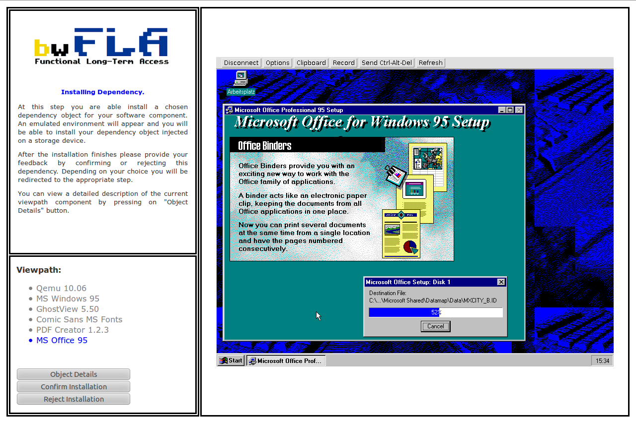
Software Archive: Installation of SW

Slide 30
bwFLA – Access Workflow

Slide 31
A glimpse into the near future
Emulation is on its way to become a mature and accepted strategy for digital archiving
Emulation has no alternative for certain types of digital objects
The workflows shown only appear (at first sight) to be expensive and/or tedious
  De facto only little magic required (so far)
  Some workflows require human interaction
  → preservation planning focusses on emulator
  → „authentic“ rendering is guaranteed
  → preservation of user knowledge

Slide 32
Consequences ...
Lesson learnt:
  To ensure a long term perspective, the long term archival community must engage in the development of Open Source Emulators
    So far not a core business of libraries
  Continuous and early testing of old hardware and systems which are no longer produced
Cooperation and distributed work are necessary:
    share the knowledge
    share the pain
    share the cost
    share the gain ☺

Slide 33
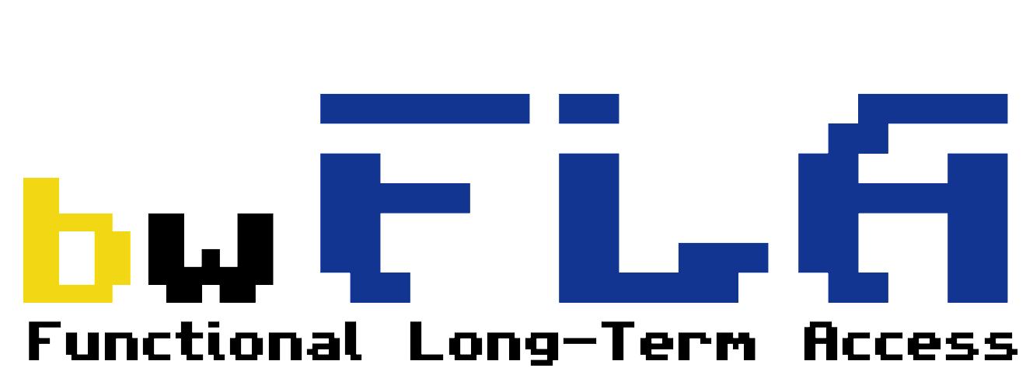
University of Freiburg
  Concept, project management and development
University of Ulm
  Sci. data and integration of university libraries
Bibliotheksservice-Zentrum Baden-Württemberg
  Integration, meta-data and coordination of libraries
Landesarchiv Baden-Württemberg
  Archive-integration, meta-data
KÜdKA KIT Karlsruhe / HfG Karlsruhe
  Integration with HfG Karlsruhe archives (digital art)
Functional Long-Term Archival and Access through Emulation
Leitung: Klaus Rechert, Albert-Ludwigs Universität Freiburg

Slide 34
Summary (1)
The FLA approach considerably widens the chances to „reactivate data“
  Unfortunately it does not solve every issue
Open questions remain:
  Online-environments, time dependent environments
  Digital art
    Very often singular items with system modifications to support the concept of art
      We are working on it!
  Legal issues: may we emulate a hardware?
    How do we get the specifications?
      Specs are available – already during the development of the hardware
    Do we get the necessary (proprietary) software?
      Apparently the Netherlands are more advanced than Germany

Slide 35
Summary (2)
A successful digital long term archival concept will require many cooperating specialists
  IT centres can rescue and transport binary data into the future – without understanding the contents
  Libaries will only be able to serve part of the „scientific environment“
  Additional specialists from different institutions will have to care about the usability of data in their sections
    Research infrastructures become important in a much wider context
    In future projects cost factors of data must be considered in advance – otherwise everything will vanish
      INF-projects are still having a difficult position

Slide 36

Summary (3)
Research infrastructures must start to exert pressure:
  „valuable“ data are those which can archived without any loss of information
    What about proprietary environments ?!
  What are the future standards?
    Levels of abstraction?
  Can we really reach the goal?
What can we afford?
  financially?
  technically?
  manpower?
The future remains fascinating!
These slides are technically
simple and thus well
suited for digital long
term achival

