Slide 1
Digital Preservation as a service
Jo Rademakers
Rosetta Advisory Group Meeting
Hannover – 16-17 July ’12
Director LIBIS

Slide 2

Comprehensive University
  Including the Bachelor’s campus in Kortrijk
  3 groups,14 Faculties:
    Science, Engineering and Technology
    Humanities and Social sciences
    Biomedical sciences
38.640 Students (15% international; 2011)
5199 Peer reviewed publications (2010)
98 Spin-offs (2011)
68 [QS World UR 2011]
67 [THES 2012] )

Slide 3
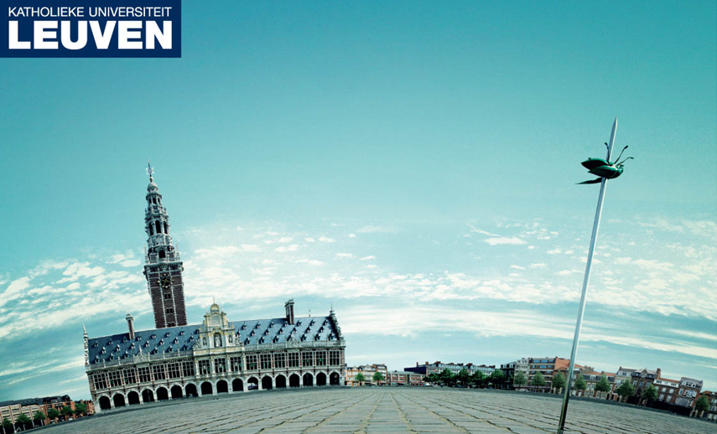



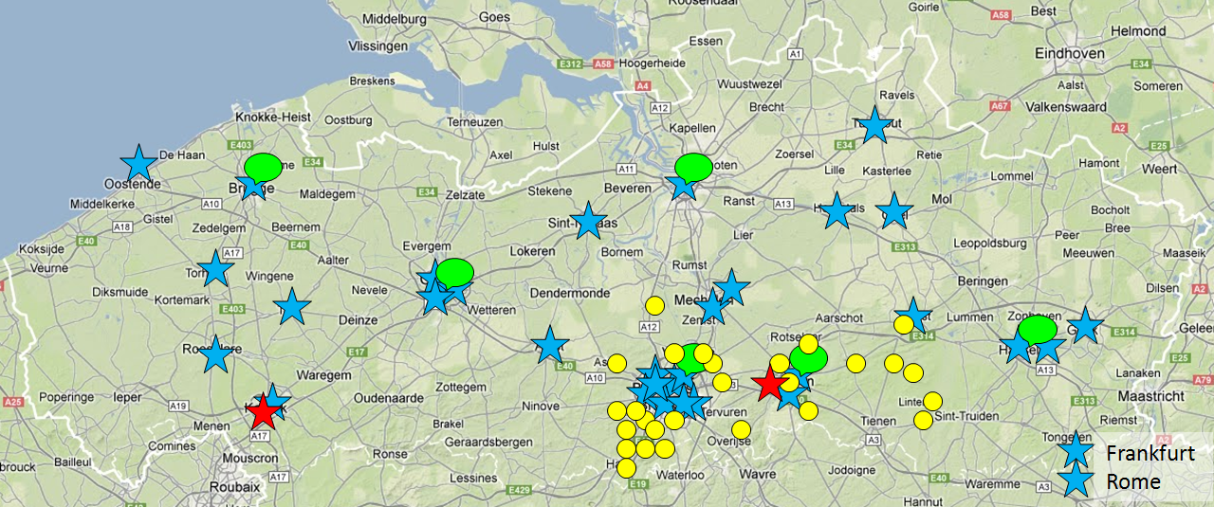
Leuven Integrated (B)Library and Information System
Part of K.U.Leuven responsible for central library automation
  Governed by a management board
Since early 70’s
Service offer for external organisations (> 70)
16 qualified persons
  + experts of library, archives, ICT
Partnership with Ex Libris

Slide 4



































Slide 5











Library
Archive
Museum
Academic
Public layer
Publishing
Discovery and Delivery
Primo
Primo Central
Linking
SFX
bX
Management layer
Print
Electronic
Digital
Alma
Alma
Aleph
SFX
Verde
DigiTool
MetaLib
Repository layer
Rosetta
Notes:
Typical library data, archival data, research data

Slide 6
Rosetta
State of the art system
Long-term preservation
Supported by a large company
Active community
Customised interfaces
Customised workflows
Also DAM features
Flexible API’s…
Consortium features

Slide 7
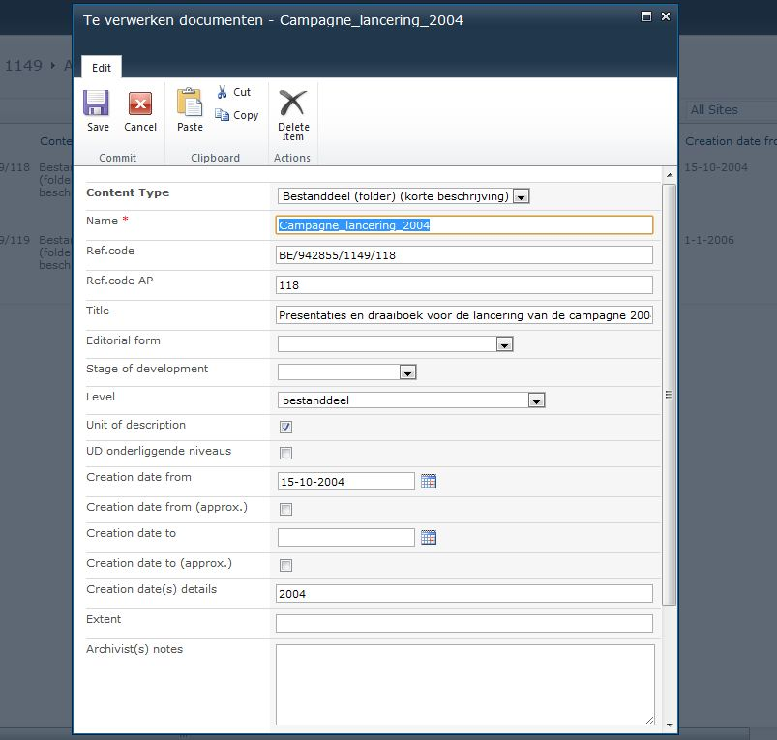






Workflows…
LIAS ingester

Slide 8
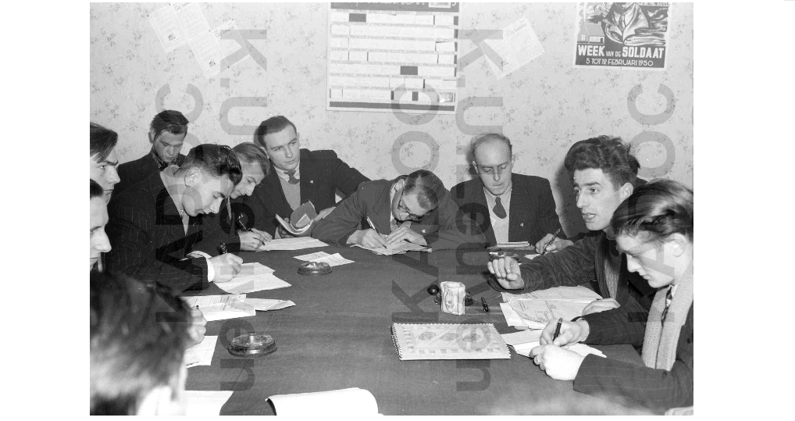
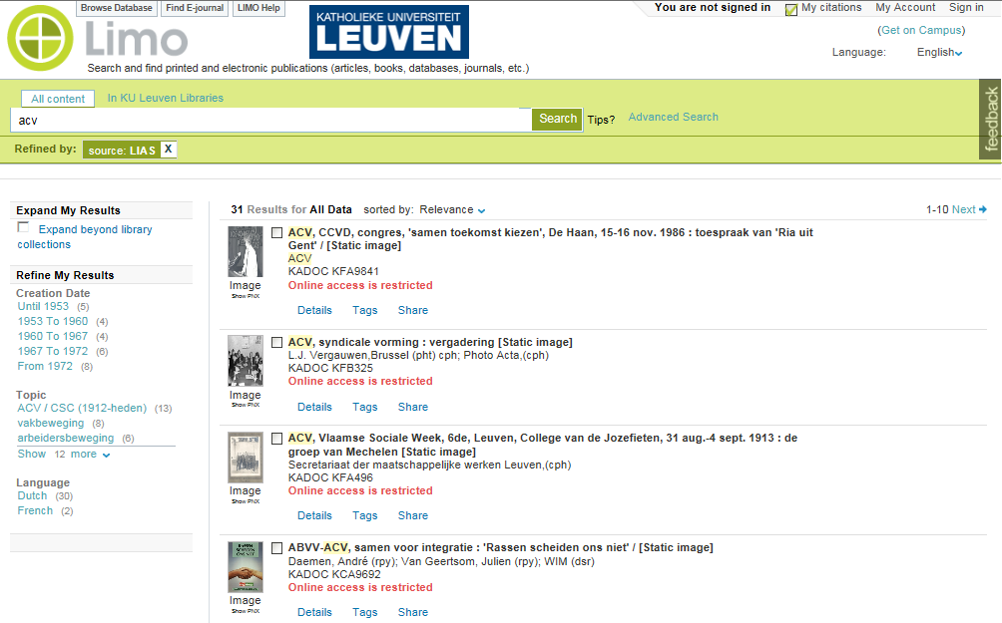
Access the data
Limo (based on Primo)

Slide 9
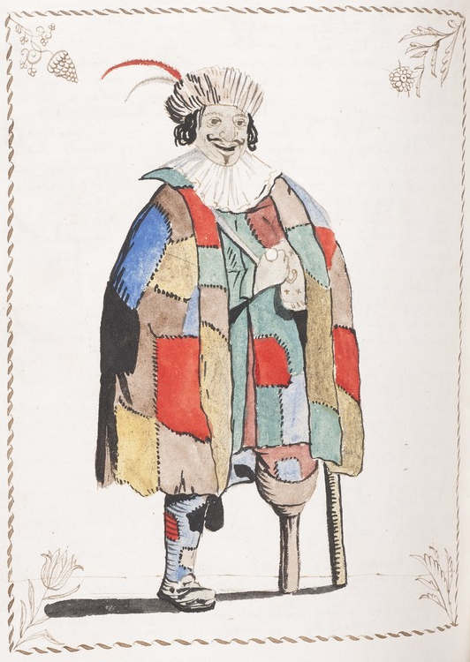

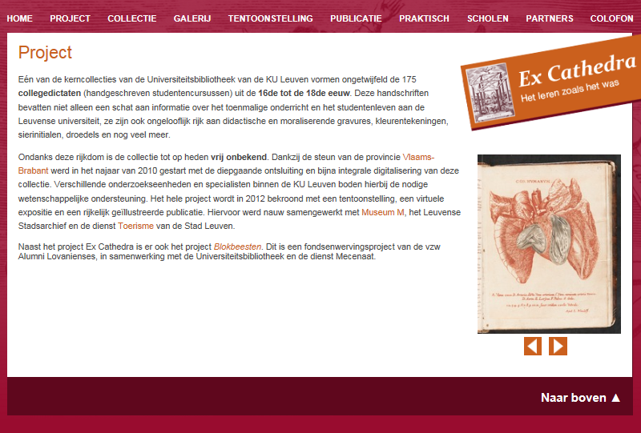
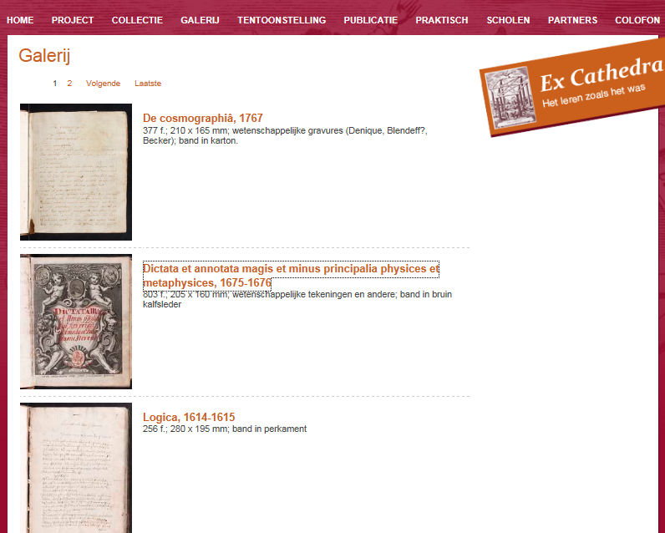
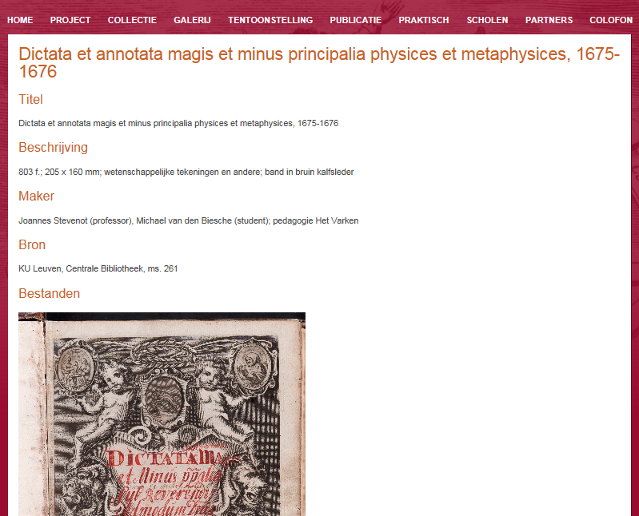
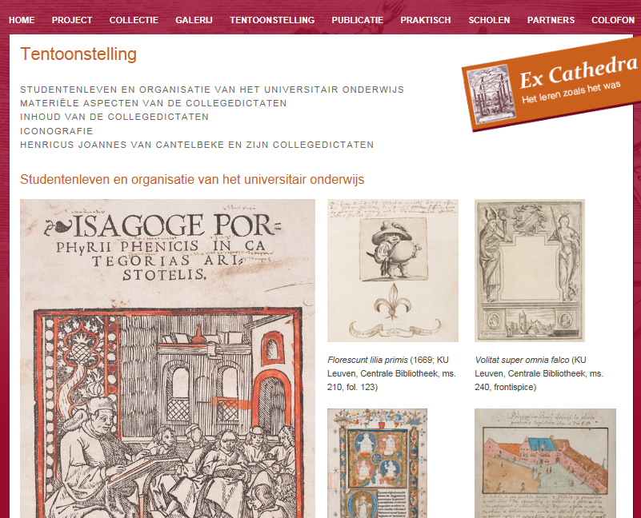
Showing the data
Based on Omeka
Web CMS
Cultural heritage
Virtual reading room
9

Slide 10
Tools
Lias uploader
  Replaces ftp
  Generates and validates checksums
Lias ingester
  Based on ingest agreement
  Automated ingest for Sharepoint
Lias Ingest Agreement

Slide 11
Ingest Agreement
Administrative data
  Organisation
    Contact
    Metadata contactperson
  Contactperson LIBIS
  Contactperson content
  …

Slide 12
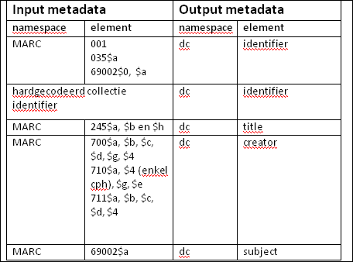
Ingest Agreement
Description
  Type of objects
  Ingestmodel
  Name of collection
  Formats
  Structure of objects : simple, complex, METS
  Permissions
  Long-term preservation requirements
  Metadata delivery: system, format, description
  Integration with other systems
  Number of objects
  Number of files
  SIP validation
  Test Ingest

Slide 13
Ingest Agreement
Planning
  Analysis
  Test ingest
  Production ingest
  Recurring ingests
Transfer of objects
  Method
  Recurrence

Slide 14
Ingest Agreement
Validation
  Viruscheck
  Checksum
  File format
  Normalisation
Ingest Validation
Financial
  Who is going to pay? Now and tomorrow!
To do

Slide 15
Storage
Different options
  Mirrored NAS (RAID-5) (NetApp)
  Single NAS (RAID-5)
  TSM Backup
  Remote storage
  Cloud services

Slide 16
Functional Support
Complete Management
Migration services
  Configuration
  Training
Manuals
Incident management
Helpdesk (24/7)
Project management
>> Service Level Agreement

Slide 17
Central Infrastructure
Redundant
99,8 % availability
24/7/365 monitoring
Service slots
Service packs
>> Service Level Agreement

Slide 18
Networking
Working groups
  Exchange best practices and experiences with colleagues
Advisory Board
LIBISnet User Group Meeting
Igelu, Vlengel, Rosetta Advisory Board
  Influence future developments through partnerships
Regional, national and international projects, …
Account management

Slide 19
The team
16 persons with a large expertise in library and archive (…) automation ( > 250 years)
  Business consultants
  Analist-developers
  Infrastructure architect
  Project managers
  Account managers
Experts in specific domains and modules
  + experts from the libraries and ICT
Like to hire some more…

Slide 20
Financial
Licenses & software
  Negotiate yourself vs have it done by experts
  Own contract vs central contract
  Configure, upgrade, update yourself vs have it done by a knowledgable centralized team
Hardware
  Buy and maintain infrastructure yourself vs contribute to central infrastructure
Cataloguing
  Catalogue all records yourself vs just add your information
Staff
  Have IT-staff and system managers vs contribute to a central staff

Slide 21
Pricing
One-time fee
  Including configuration, training, migration…
Annual cost
  Fixed cost based on the size of the project / organisation
    Including licenses, maintenance, support, management…
  Variable cost based on Tb
    Packages of 100 GB

Slide 22
Conclusion
Awareness…
Win-win situation
  For the partner organisation
  For LIBIS @ KU Leuven
  For the community
  For Ex Libris

Slide 24
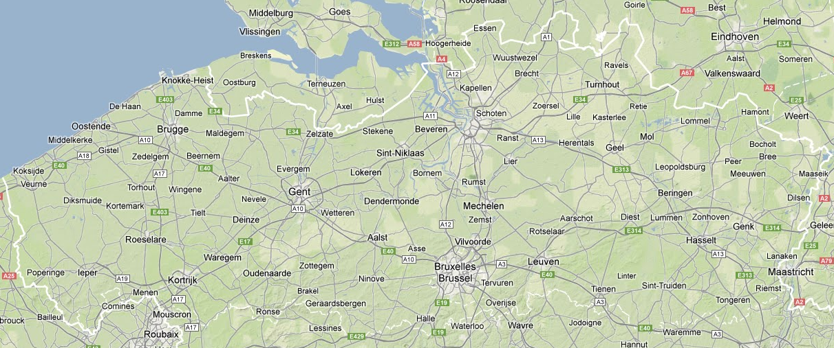
Frankfurt
Rome

