Slide 1








Leibniz Library Network for Research Information
Automatic Ingest via Submission Application
Project updates ZBW (Goportis)
17th July 2012, Hannover
Yvonne Friese
Project Manager ZBW Kiel, Goportis

Slide 2
Preview
Introduction
The Challenge
Ingest: The manual Workflow
Ingest: Personnel Costs
Ingest: The automatic Workflow
PDF Validation – Automation needed
Summary and Future Work

Slide 3
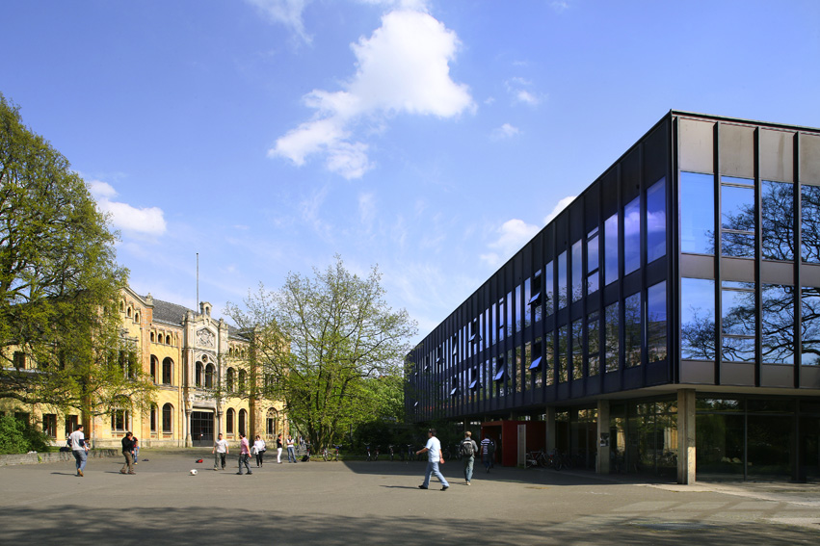
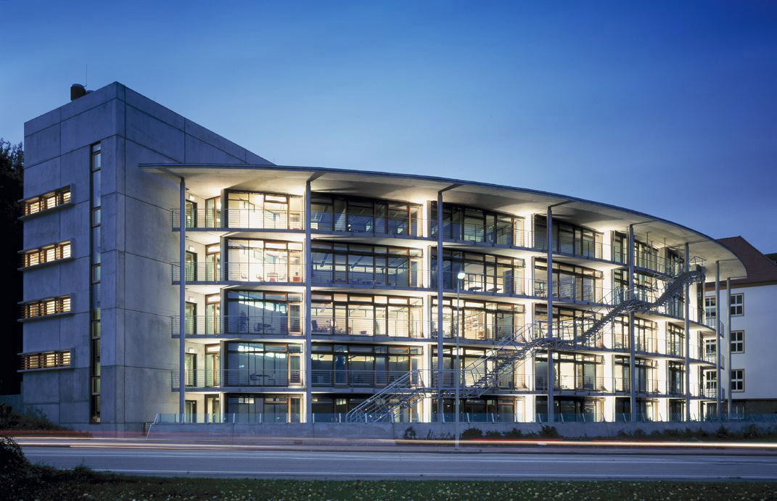
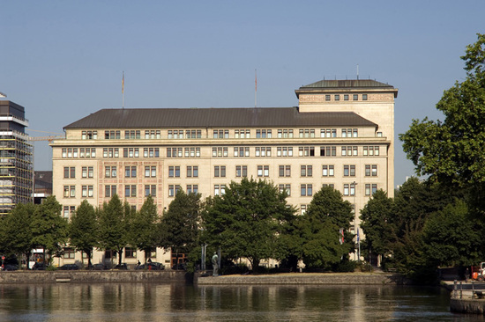
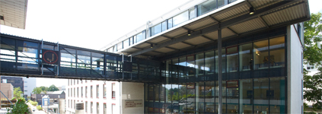

Goportis
  Consortium of the three National Subject Libraries in Germany
  German National Library of Science and Technology (TIB Hannover)
  German National Library of Medicine (ZB MED in Bonn and Cologne)
  German National Library of Economics (ZBW in Kiel and Hamburg)
  Goals: Share synergies and knowledge
TIB Hannover
ZBW Kiel
ZBW Hamburg
ZB MED Köln
ZB MED Bonn

Slide 4
Digital Preservation Pilot Project (Goportis)
  April 2010 - September 2011 (18 months)
  Personnel involvement:
    3 project manager (full time -1 for each library)
    6 librarians (part-time)
    2 IT-Developer (part-time)
    1 System-Administrator
    Status Quo July 2012: Investment in new hardware for a scalable and robust productive system. Last preparations to start the productive system.

Slide 5
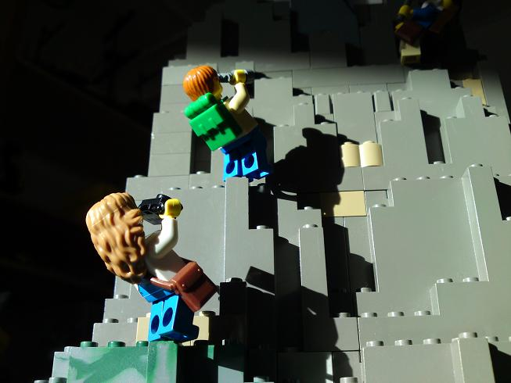
The Challenge
Picture by Thomas Stracke

Slide 6
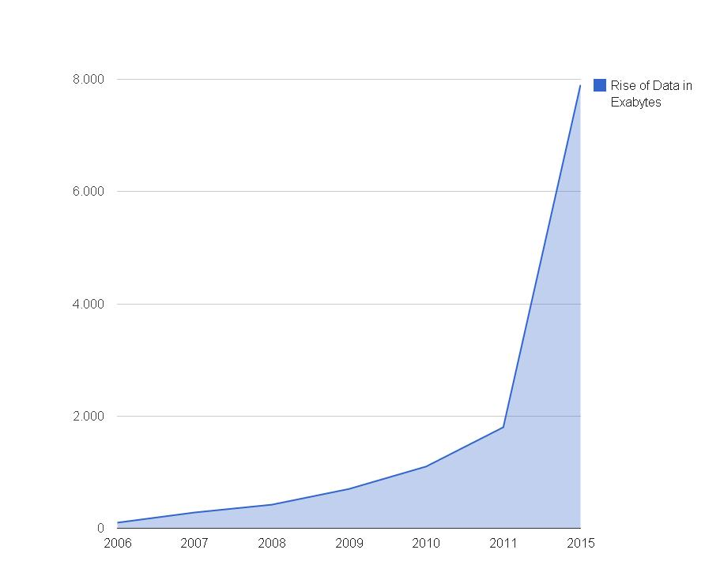
Rise of Data
URL: Source of numbers: IDC’s Digital Universe Study, sponsored by EMC, June 2011, http://www.emc.com/collateral/demos/microsites/emc-digital-universe-2011/index.htm
and “The Diverse and Exploding Digital Universe” IDC White Paper, March 2008
http://www.emc.com/collateral/analyst-reports/diverse-exploding-digital-universe.pdf

Slide 7
ZBW – Our digital collections
  Ingest 2012:
    DSpace Repository (almost 40,000 PDFs)
    Newspaper articles (more than 200,000 JPEGs)
  Future Ingest into the Archive:
    Journal Articles (more than 23,000 – html objects + PDFs)
    Web Archiving
    tbc

Slide 8
Ingest: the manual ZBW Workflow
The ingest of digital object includes the following tasks
Chose digital Object (+ transfer and upload to Rosetta)
Enrich with metadata (from consortial catalogue)
Rosetta performs following Ingest tasks automatically
Run Virus Check
Identify Format (DROID)
Check if file is valid and well formed (JHOVE)
Create technical metadata
Create Checksums for object
Additional task after the Ingest if file not valid / well-formed
migrate to valid and well formed file
→The estimated time per digital object if ingested by hand adds up to 15 minutes. Estimated personnel cost for 15 minutes: around 10 Euros (including migration, if necessary)

Slide 9
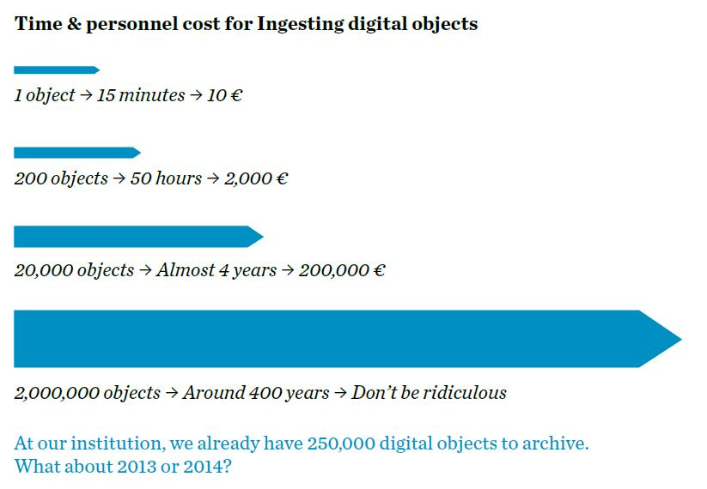
Ingest: Personnel Costs

Slide 10
Our Decision (ZBW)
Ingest the data into the Archive automatically (via Submission Application)
automatically migrate all not well-formed /not valid PDFs to valid PDFs
use Rosetta to its full automation capabilities

Slide 11
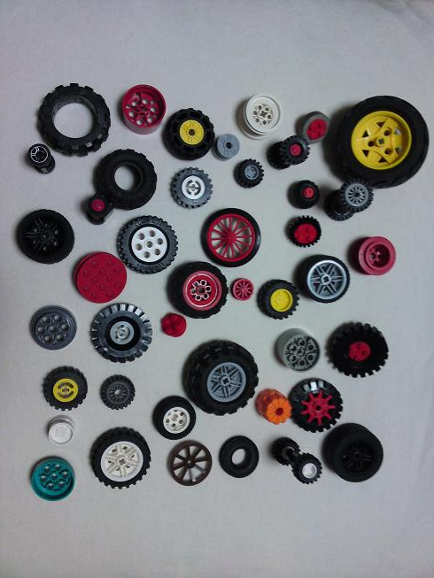
There are already many wheels
Picture by Thomas Stracke

Slide 12
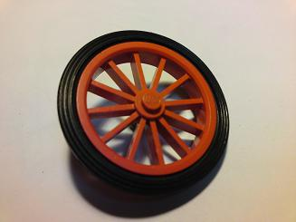
Does everybody need a wheel?
Discussion at the DCH2012 in France (Cartographers)
Perequesite for a migration decision to a valid + well-formed file is the existence of a validation tool that works for the certain format
Picture by Thomas Stracke

Slide 13

Submission Application Costs
Developing the Submission Application lasted less than a month and cost under 3,000 €.
Maintenance cost only around 1,000 € per year.
Compare to the manual ingest of nearly 40,000 Objects – current amount of objects in our DSpace Repository (400,000 €)
→ this decision is based on the ZBW Dspace Repository. For other collections another solution might be better.
Thommy Weiss_pixelio.de

Slide 14
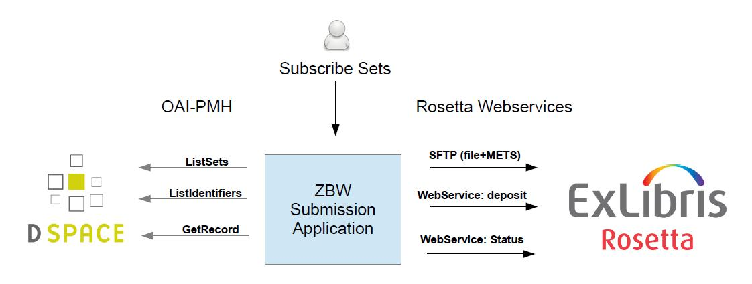
Workflow: Submission Application

Slide 15
Ingest: The automatic Workflow
The Submission Application
  collects digital objects and their metadata from the Dspace Repository (using OAI-PMH)
  creates Intellectual Entities with Mets and files
  moves them to the shared folder
  ingests to Rosetta (includes e. g. format identification via DROID and format validation via JHOVE)
  gets status information via Web Service
  enrichment with Metadata (autom.) via consortial catalogue (GBV)

Slide 16
Submission Application Tasks
Tracking of the Object (WebService GetStatus), 5 possible stages:
Initialisation
Validation
Enrichment
To Permanent
Finished

Slide 17
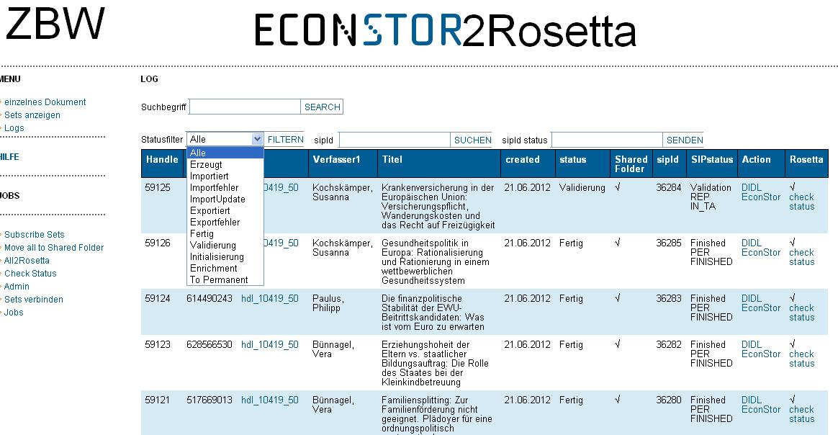

Slide 18
JHOVE Validation: PDF
  14 % of the PDFs are not yet valid
  The manual migration to a valid file of 5000 PDFs would cost ca. 50,000 € (only Personnel Costs). We need an automatic solution to generate valid files to save ressources & money.
  An automatic solution to check wether or not the migrated version looks like the original still needs to be tested.

Slide 19
Automatic Validation
  Present Decision at the ZBW
  Ingest -> Risk Analysis –> Preservation Plan(s) (Testing + Evaluation) –> Decision -> Preservation Action (Migration via Tool like itext, Ghostscript or a proprietary tool)
  Tests of a small amount of the data with itext have shown a success of 98 % (the rest will still need hands-on-treatment)
  The workflow needs to be evaluated regularly:
    Is JHOVE still working for our objects?
    Migration to another format instead of just to a valid PDF (e. g. PDF/A-2b)?
    Are there any better Validation Tools, Migration Tools etc.?
    as the architecture of this workflow will be modular, it will be easy to modify it

Slide 20
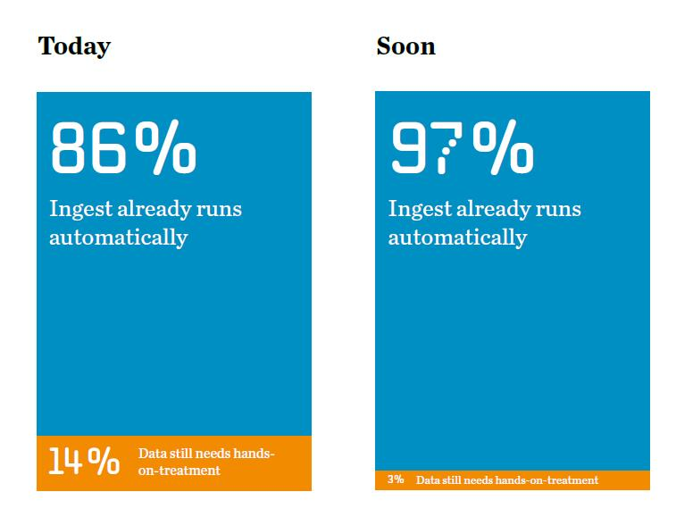
Pushing 100% Automation

Slide 21
Summary and Future Work
  ZBW
  complete the automatic Validation Workflow
  develop a Workflow for JPEGs (modify Submission Application for the next Ingest Task)
  ZB MED
  complete the automatic Ingest Workflow from ElliNET to Rosetta
  develop an automatic Ingest Workflow for the digitized objects of the Physical Anthropology collection (tiff master, jpeg and pdf derivatives)
  TIB
  textual materials: extension of manual workflows (dissertations, research reports) and integration into daily work routines of collection departments, import of older materials through submission application
  non-textual materials: development of AV-workflow, development of workflow for 3D objects

Slide 22
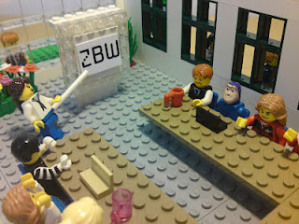
Questions?
Yvonne Friese
ZBW Kiel
Project Manager Digital Preservation
y.friese@zbw.eu
Picture by Hugo Wallitzer

